Slide 1
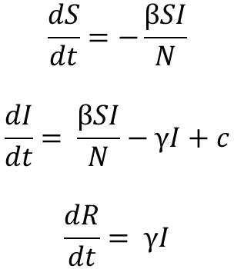
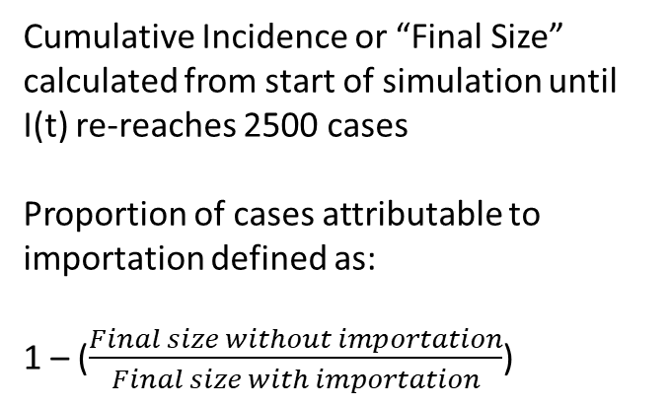
Model Structure
$$\frac{dS}{dt}=−\frac{βSI}{N}$$
$$\frac{dI}{dt}= \frac{βSI}{N}−γI+c$$
$$\frac{dR}{dt}= γI$$
Cumulative Incidence or “Final Size” calculated from start of simulation until I(t) re-reaches 2500 cases
Proportion of cases attributable to importation defined as:
1 – (𝐹𝑖𝑛𝑎𝑙 𝑠𝑖𝑧𝑒 𝑤𝑖𝑡h𝑜𝑢𝑡 𝑖𝑚𝑝𝑜𝑟𝑡𝑎𝑡𝑖𝑜𝑛郝𝐹𝑖𝑛𝑎𝑙 𝑠𝑖𝑧𝑒 𝑤𝑖𝑡h 𝑖𝑚𝑝𝑜𝑟𝑡𝑎𝑡𝑖𝑜𝑛)
Initial Conditions
N = 5000000
S = 4997500
I = 2500
R = 0
Parameters
Doubling Time = 3 days
Gamma = 4997500
Beta = Varies (1.1 < R < 2.0)
Infectious Importations per day (c) = 5 per day

Slide 2
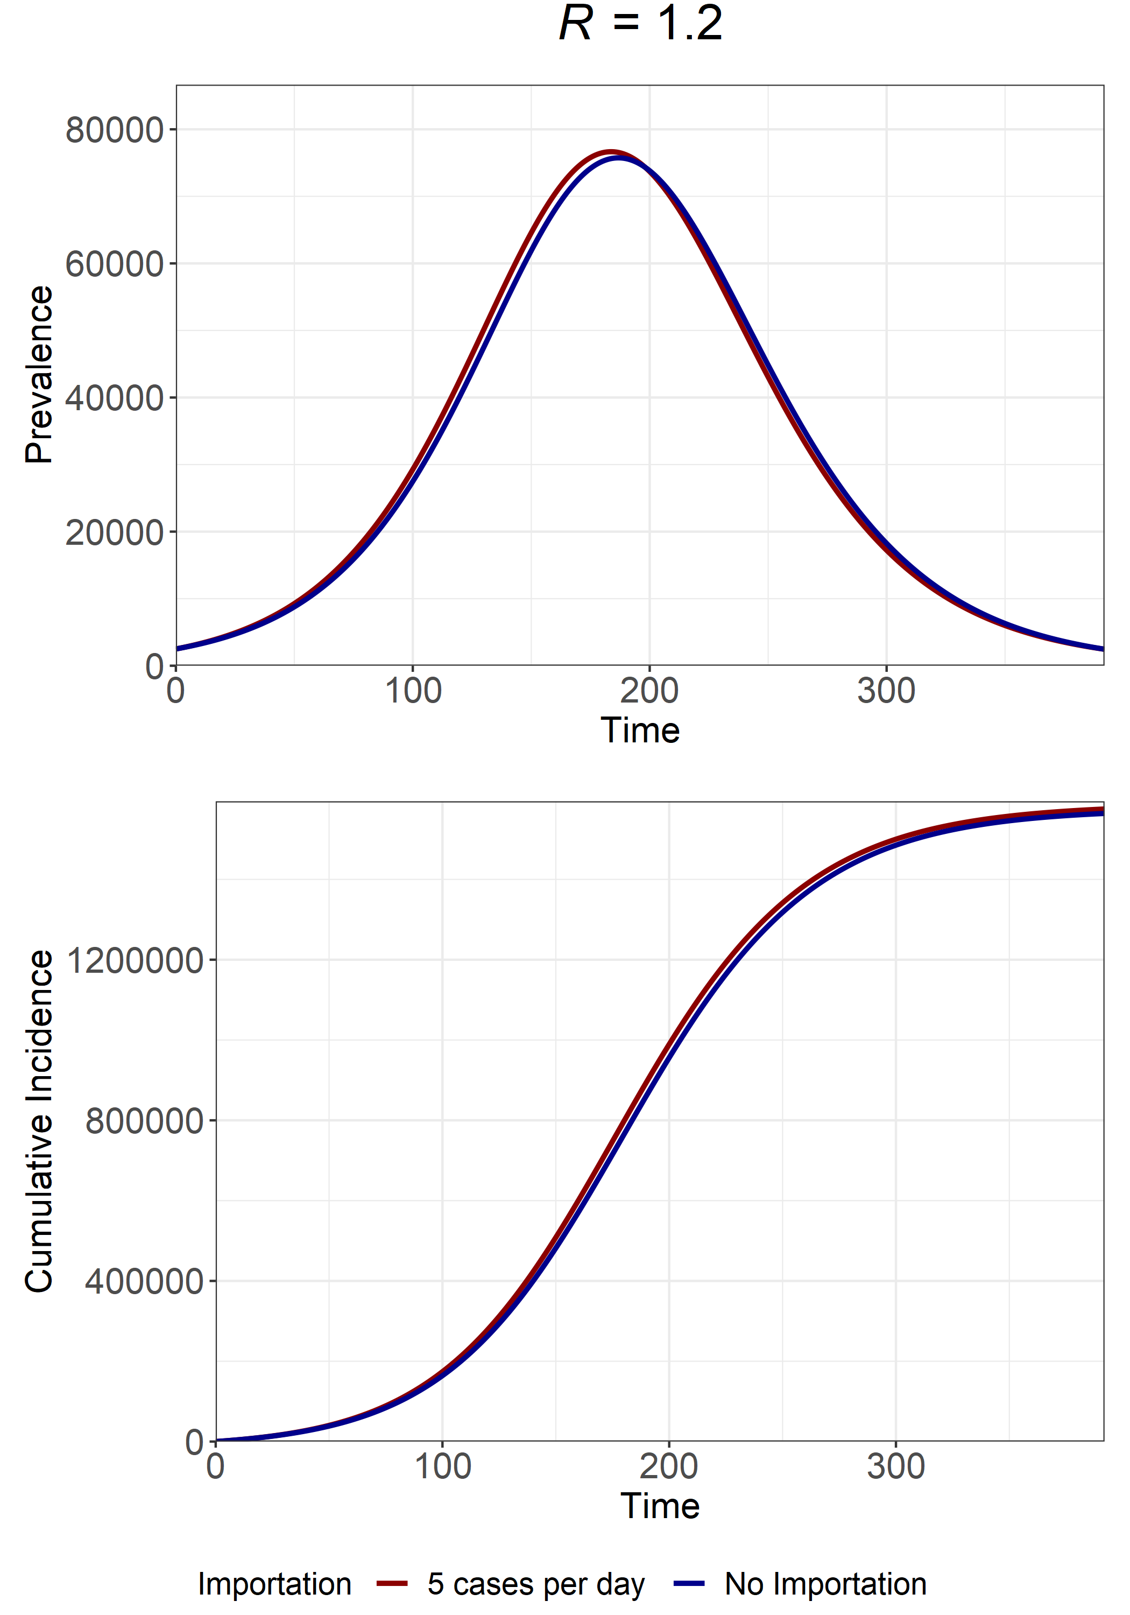
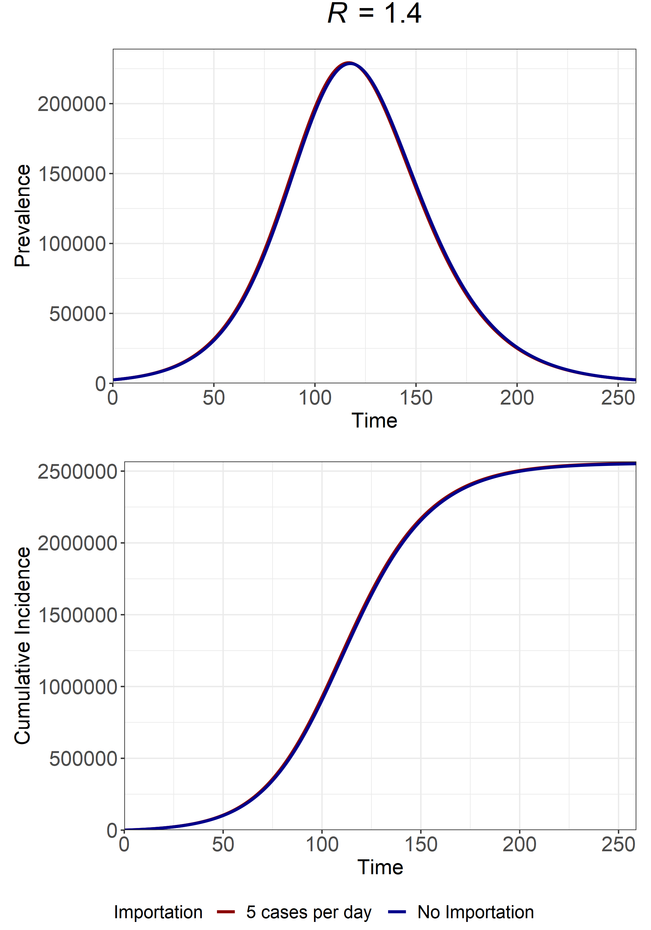
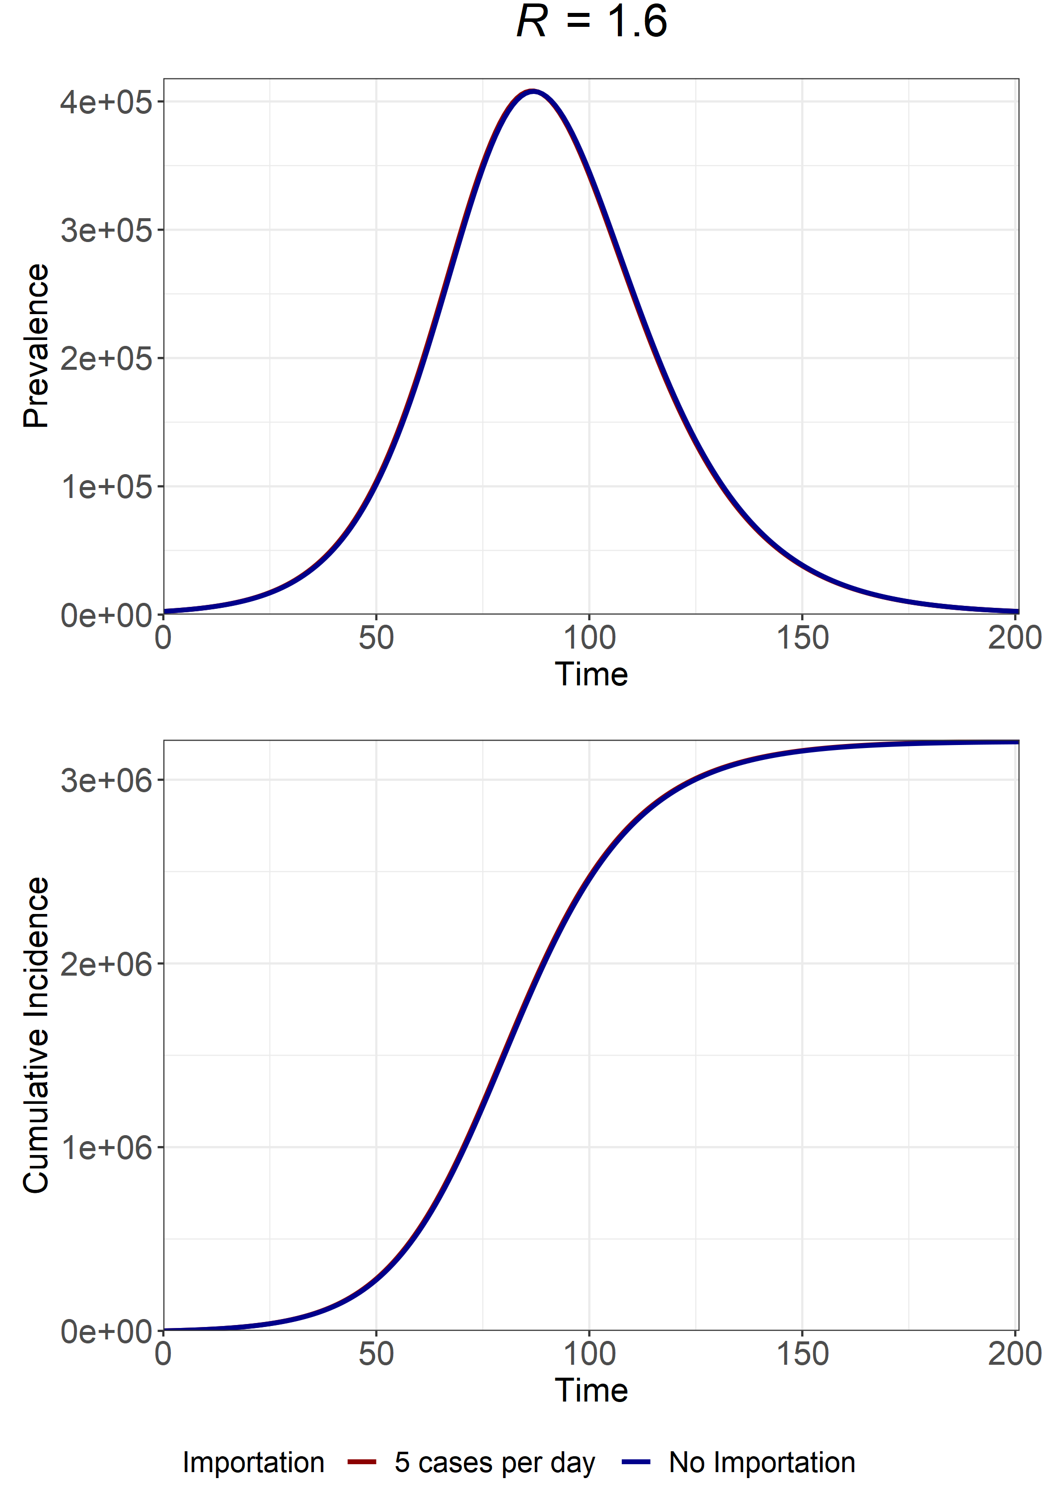
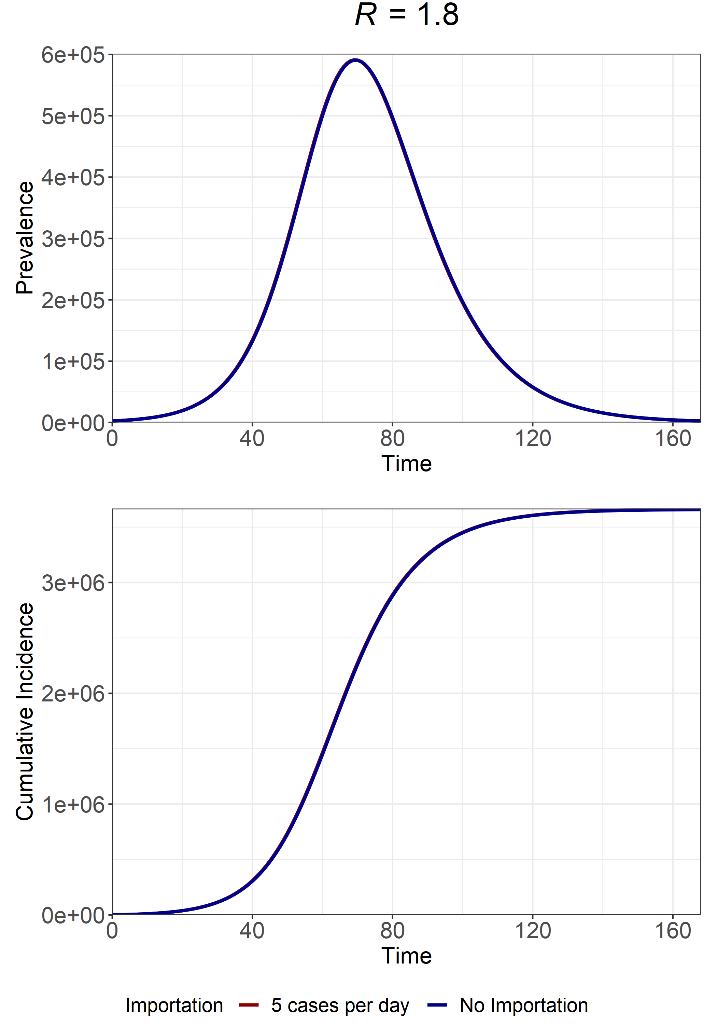
R
1.2
1.4
1.6
1.8
Final Size at I(t) = 2500
Importation = 1575336 cases
No Importation = 1564216 cases
Importation = 2555141 cases
No Importation = 2551098 cases
Importation = 3208534 cases
No Importation = 3206231 cases
Importation = 3660239 cases
No Importation = 3658654 cases
Fraction of Epidemic w/ Importation attributable to Importation?
0.007%
0.001%
0.0007%
0.0004%

